Slide 1
Memory Happens Now A Collaborative Strategy for Preservation of Organizational Records
Nancy Hadley, Assoc. AIA, CA, DAS
The American Institute of Architects
nhadley@aia.org

Slide 2
Problem: Preserve AIA’s born-digital permanent records at point of creation
Internal repository: creators = users
Non-public records most at risk
Voluntary compliance from 200-person staff
Small IT staff
1 archivist, plus 1-year NDSR grant resident

Slide 3
Goals from focus groups:
Keep files intact through software and system changes
Make it easy to put files in, without a lot of tedious tagging
Make it accessible to all staff to quickly find what they need

Slide 4
Traditional model
Records creator
Archivist
Arrange
Describe
Preserve
Provide Access
Create
Appraise
Use
Active
Records
Transfer
Inactive
Records
Repository
Loss

Slide 5
Core concept: Arrange and describe first, then add records
We already know what records we will produce each year
Simplifies ingest for creators
No masses of unidentified files for archivist

Slide 6
Core concept: Function, not fonds
AIA’s programs have continuity, while organizational chart changes
Functional analysis enhances discovery across the organization and across time

Slide 7
Core concept: Direct access staff-wide
Direct access is the major incentive for creators
Archivist as facilitator, not gatekeeper

Slide 8
Appraisal Records Inventory with each department identifies programs and their series
Archivist understands significance and long-term value
Creators understand their records
Result: awareness of permanent records and clear outline of what to keep

Slide 9
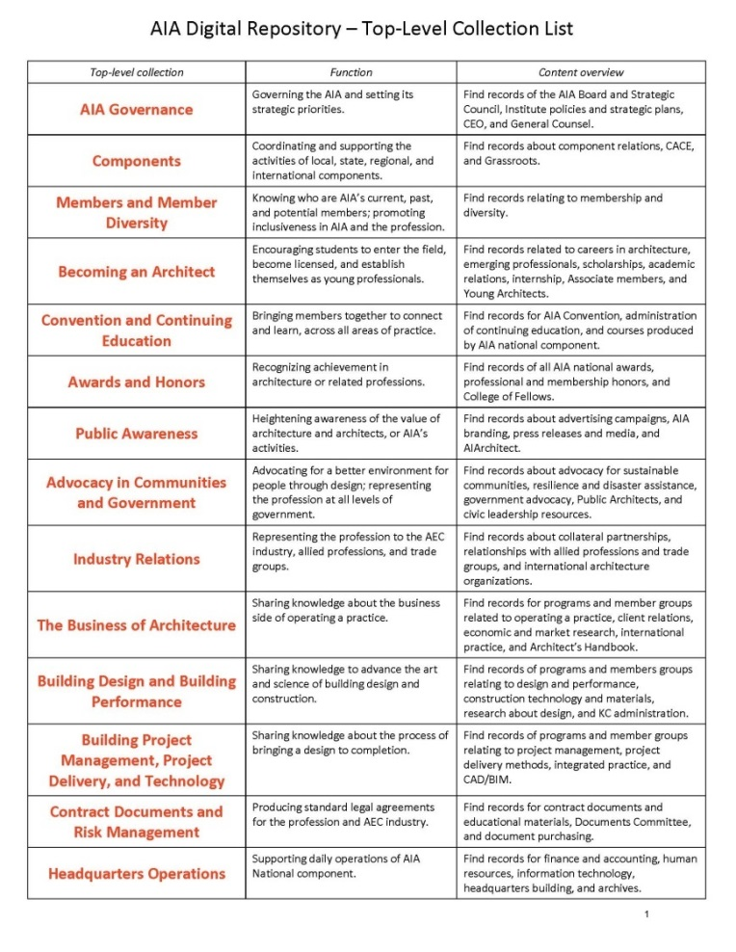
Arrangement Basic unit = program/activity, clustered into top-level functions
Archivist does functional analysis
User testing with creators and against past records
Result: context and co-location for better access

Slide 10
Arrangement

Slide 11
Description History note at program level, and kept updated
Archivist provides initial history note and other EAD
Creators add name changes and program end dates
Result: Context is preserved along with records as it happens. Organizational memory is accessible to all.

Slide 12
Participation During Development
2010 | Initial Planning
2011 | Business Case, focus groups
2013 | Project Plan, focus groups
2014-15 | Selected as NDSR host, resident begins June 2015
June 2015 - July 2016 | Records inventory with departments, system selection, customization and setup
Adoption Begins
August 2016 | Rollout to all staff
2017 | “Save It NOW Find It Later” campaign

Slide 13
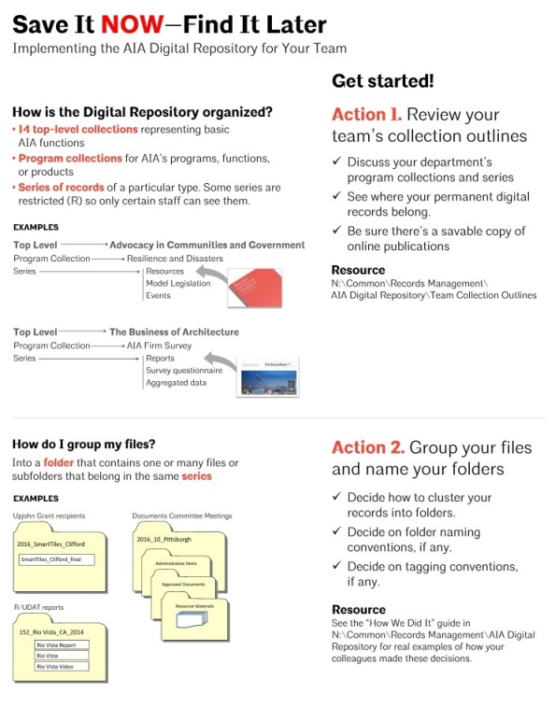
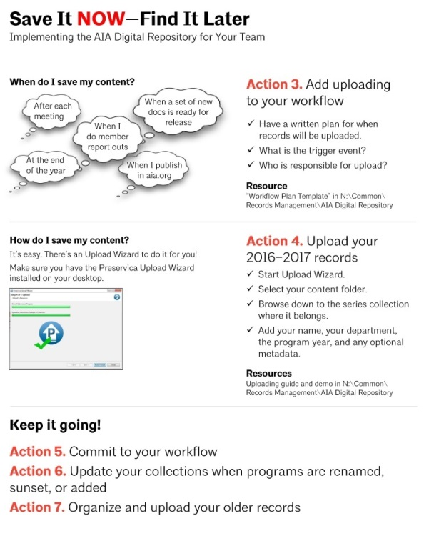
Save It NOW summer campaign
Action steps & user guides
Make uploading part of routine workflow for all departments

Slide 14
Incentives for Change
Common pain points: lost or hard-to-find records
Participation by creators from the start
Reflect how creators use their records
Senior management buy-in
Step-by-step process for adding records
Publicize repeatedly
Individual walk-through with small groups of creators
ACCESS is the biggest incentive

Slide 15
Preservation through Collaboration
Traditional Model
AIA Collaborative Model
Records creator
Archivist
Appraise
Arrange
Describe
Create
Preserve
Provide Access
Deposit
Use
Records
Repository

